Slide 1
Genetic algorithm
Optimize Routing Problem

Slide 2
Introduction
Welcome to our presentation on Genetic Algorithms (GAs) and Optimize Routing Problems (ORPs). Optimization is crucial across various domains, from logistics to resource allocation. At the heart of optimization lies the Shortest Path Problem (SPP), seeking the most efficient route between two points in a network. However, real-world challenges like traffic congestion and dynamic environments make this task complex. Genetic Algorithms offer a promising solution, inspired by natural evolution. They efficiently explore solution spaces, adapt to changes, and discover near-optimal solutions. In this presentation, we explore Genetic Algorithms and their application in solving routing optimization problems, focusing on the Shortest Path Problem.

Slide 3
What are Genetic Algorithms?
Genetic Algorithms (GAs) are optimization algorithms inspired by the process of natural selection and evolution. They mimic the principles of biological evolution to solve complex optimization problems efficiently. Here's a summary:
Inspiration from Nature: GAs are inspired by the process of natural selection, where individuals with traits better suited to their environment are more likely to survive and reproduce.
Basic Components: GAs operate on a population of potential solutions, represented as chromosomes. These solutions are evaluated using a fitness function, which measures how well they perform the task at hand.
Evolutionary Operators: GAs employ several operators:
Selection: Individuals with higher fitness are more likely to be selected for reproduction.
Crossover: Genetic information is exchanged between selected individuals to create new offspring.
Mutation: Random changes are introduced into the genetic information of offspring to promote diversity.
Iterative Process: The process of selection, crossover, and mutation is iteratively applied to the population, leading to the evolution of better solutions over generations.
Termination: The algorithm terminates when a stopping criterion is met, such as reaching a maximum number of generations or achieving a satisfactory solution.
Adaptability: GAs are adaptable and can handle a wide range of optimization problems, including those with complex, multi-dimensional solution spaces.
GAs offer a powerful and flexible approach to optimization, capable of finding high-quality solutions to challenging problems. In the context of routing optimization, GAs can effectively explore routes and adapt to changing conditions to find near-optimal solutions.

Slide 4
How Genetic Algorithms Work
Encoding Solutions: Represent possible routes as permutations of cities along the commute route, like "A-B-C-D-E-F," where each letter is a location.
Initialization: Create an initial population of routes, either randomly generated or based on existing routes.
Evaluation: Assess routes based on factors like distance, traffic conditions, and travel time. Lower values indicate better solutions.
Selection: Choose routes for the next generation, favoring fitter ones with lower evaluation values. Methods include tournament selection or roulette wheel selection.
Crossover: Create new routes by combining genetic material from two parent routes, exchanging segments to produce offspring routes.
Mutation: Introduce random changes in routes to explore new possibilities and avoid local optima. This might involve swapping cities or changing their order.
New Generation: Offspring and fittest routes from the previous generation form the new population for the next iteration.
Termination: Continue the process for a fixed number of generations or until a satisfactory solution is found.
Final Solution: The best solution represents the optimal or near-optimal route for the daily commute.

Slide 5
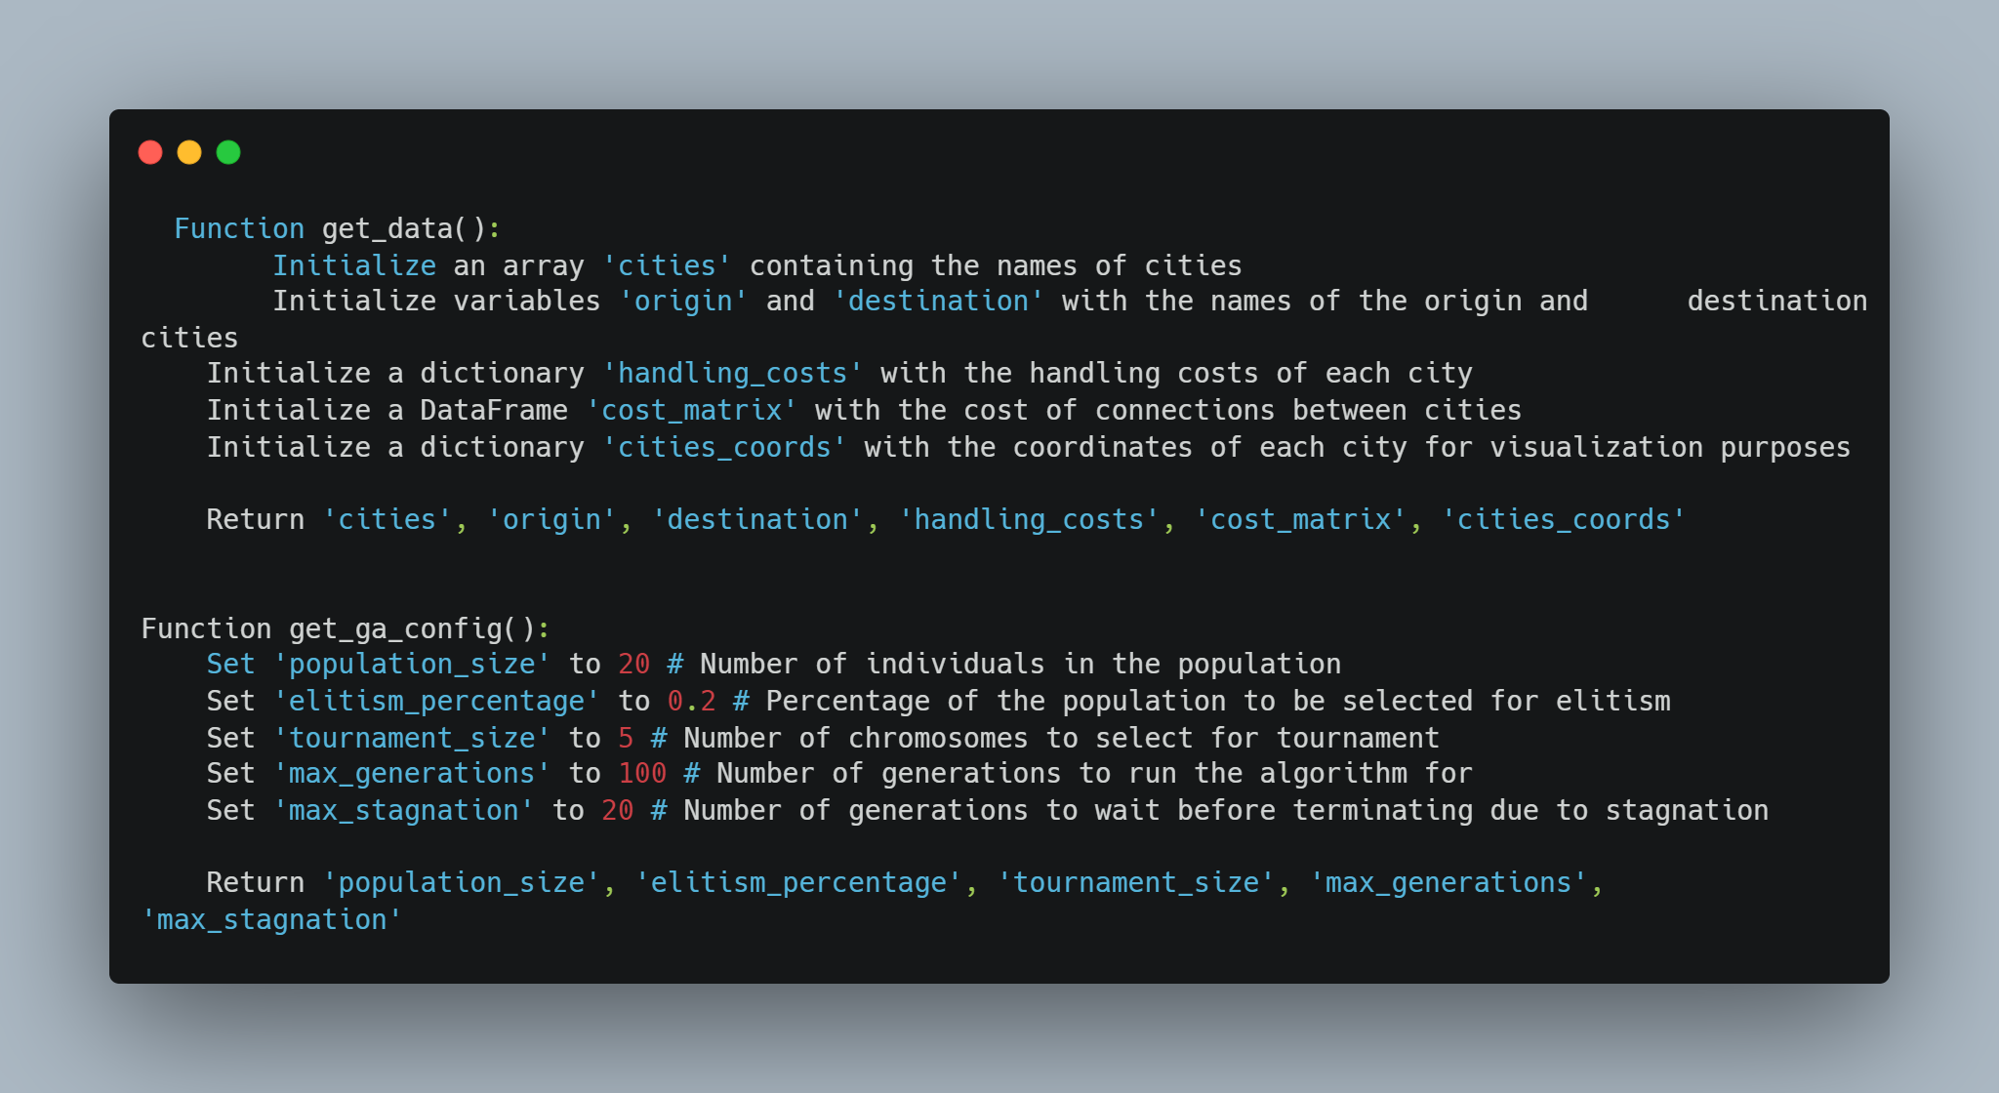
Initialization
This first function retrieves data necessary for solving the problem, such as city names, handling costs, connection costs, and city coordinates. Adjustments may be needed based on the specific implementation requirements. And the second This function retrieves the configuration parameters for the genetic algorithm, such as population size, elitism percentage, tournament size, maximum number of generations, and maximum stagnation. Adjustments may be needed based on the specific requirements of your genetic algorithm implementation.

Slide 6
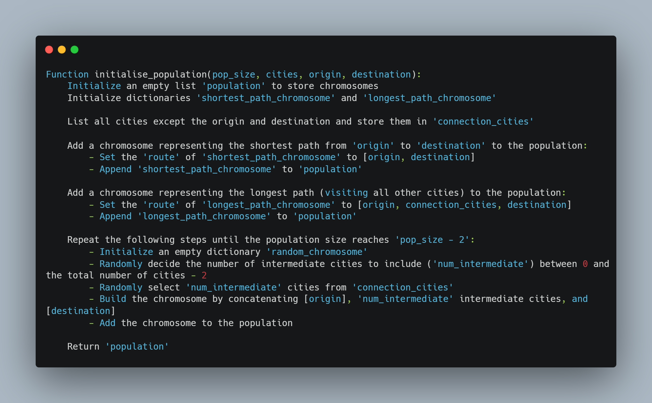
Population
This function initializes a population of chromosomes for the Genetic Algorithm. The population includes chromosomes representing the shortest path, the longest path, and random paths between the origin and destination cities. Adjustments may be needed based on the specific requirements of your Genetic Algorithm implementation.

Slide 7
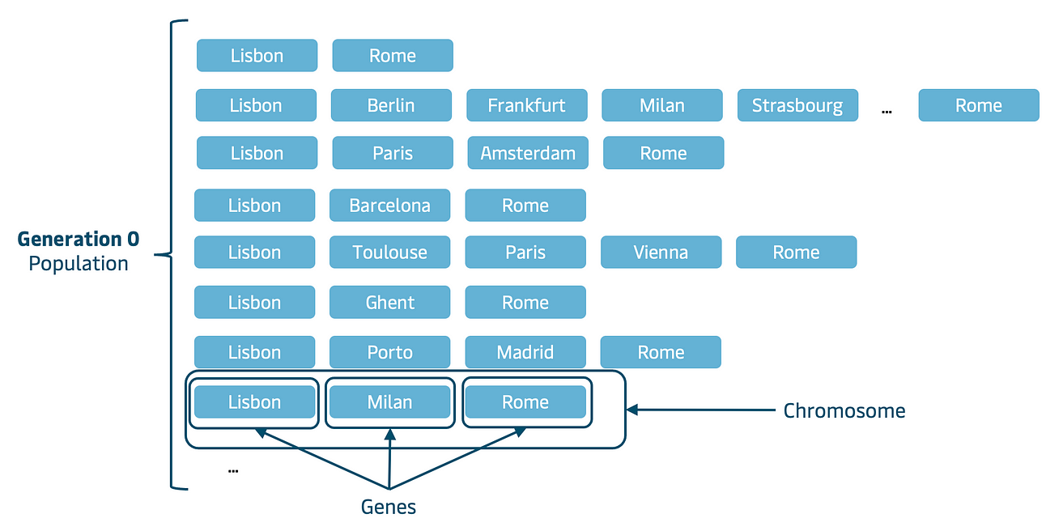
How POPULATION LOOKS LIKE

Slide 8
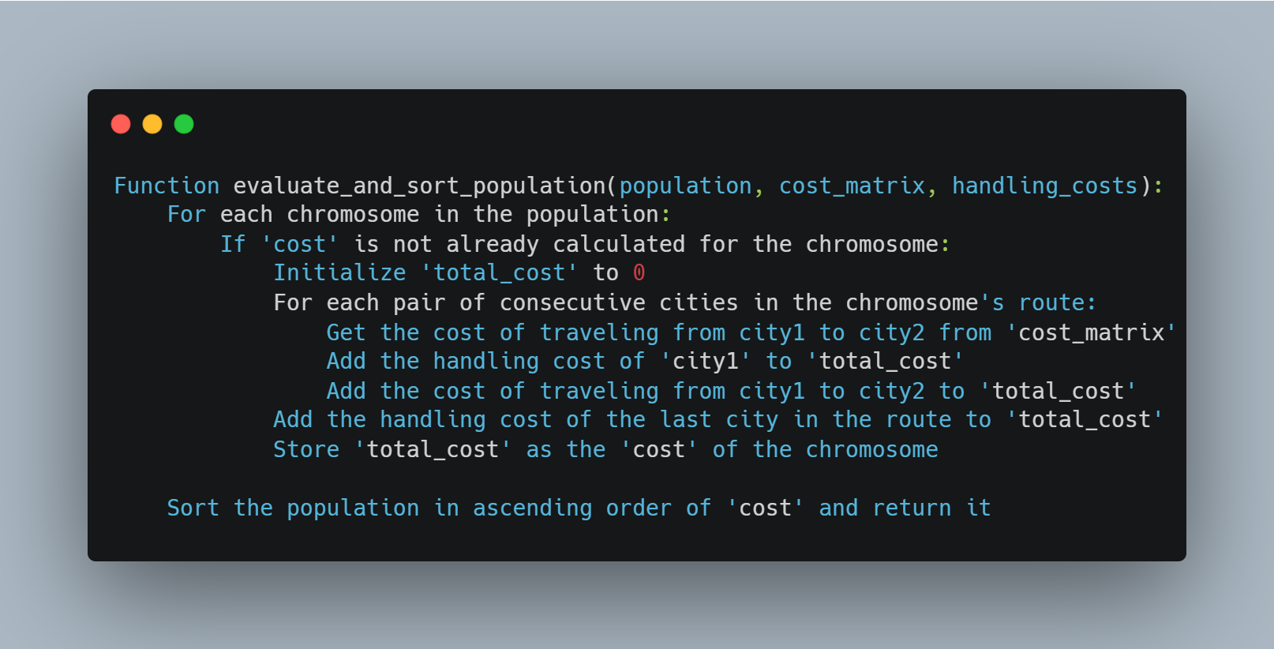
Evaluation
This function evaluates each chromosome in the population by calculating the total cost of its route based on the cost matrix and handling costs. Then, it sorts the population based on the calculated cost in ascending order. Adjustments may be needed based on the specific requirements of your Genetic Algorithm implementation.

Slide 9
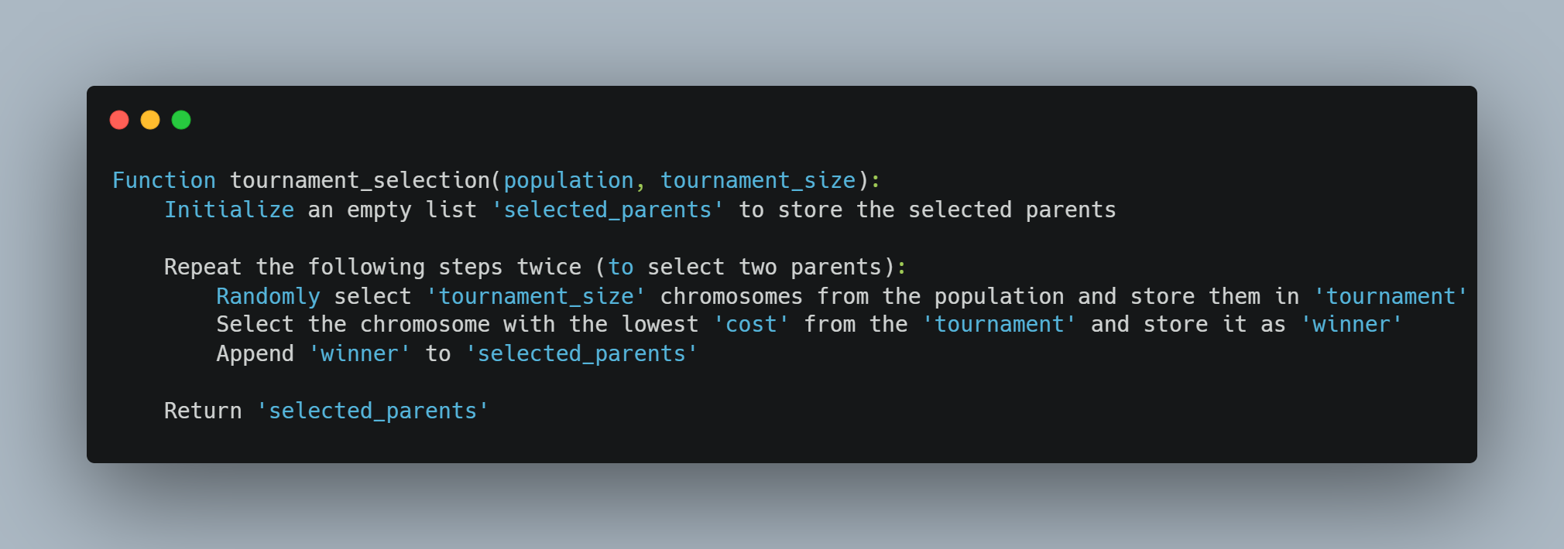
Selection
This function implements tournament selection, a method commonly used in Genetic Algorithms for selecting parents for the next generation. It randomly selects a subset of chromosomes (a tournament) from the population and then selects the best chromosome from that subset based on its cost. Adjustments may be needed based on the specific requirements of your Genetic Algorithm implementation.

Slide 10
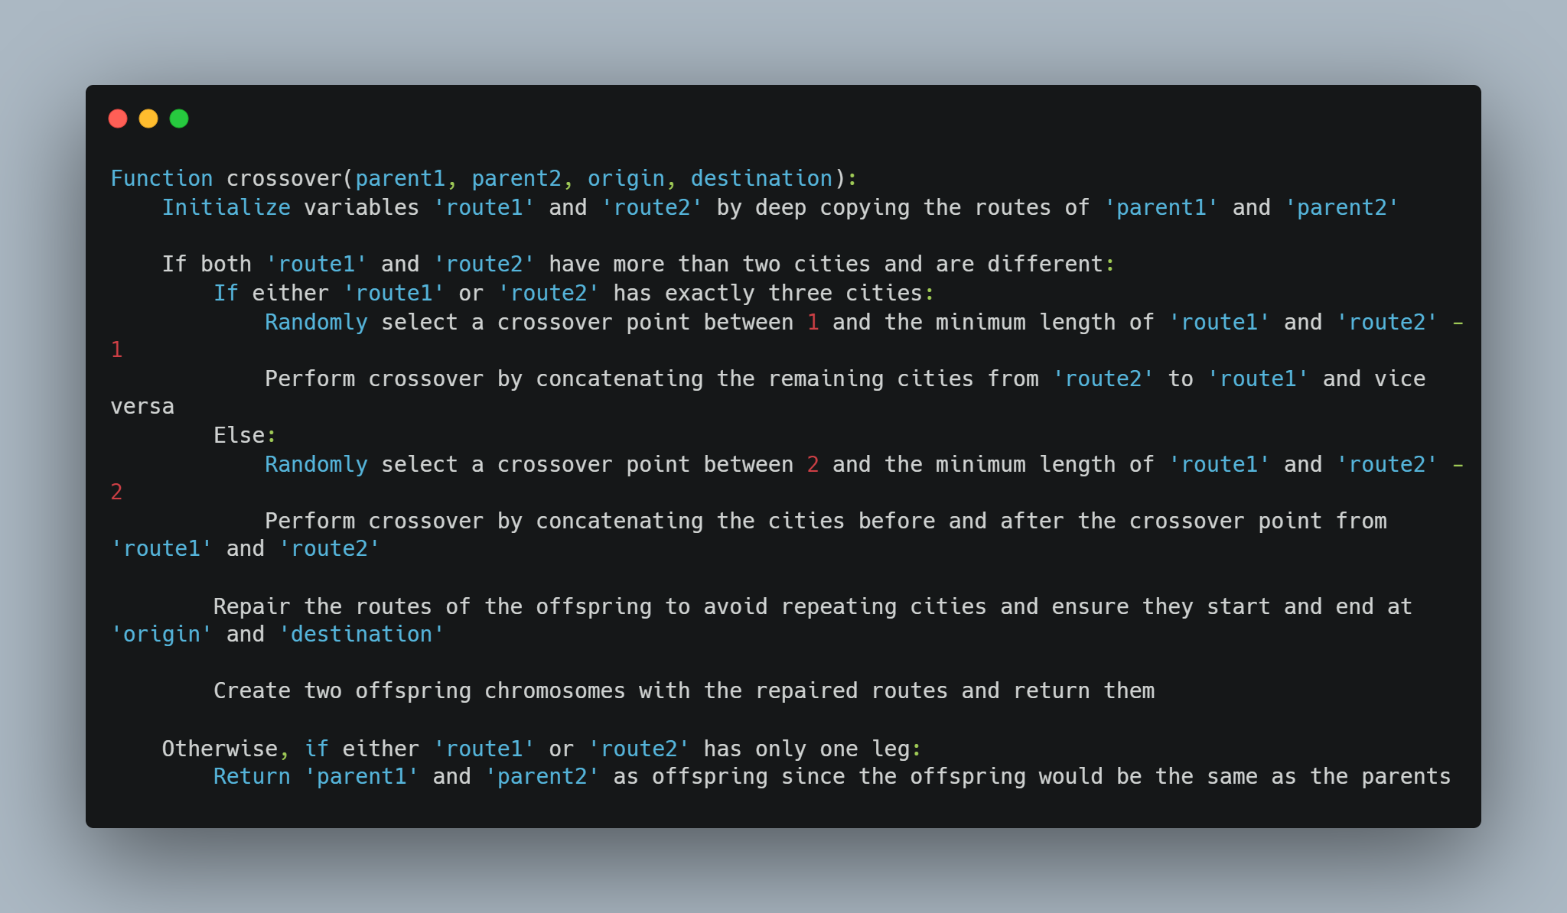
Crossover
These functions perform crossover operation on two parent chromosomes to generate two offspring chromosomes and repair the offspring routes to avoid repeating cities and ensure they start and end at the origin and destination cities. Adjustments may be needed based on the specific requirements of your Genetic Algorithm implementation.

Slide 11
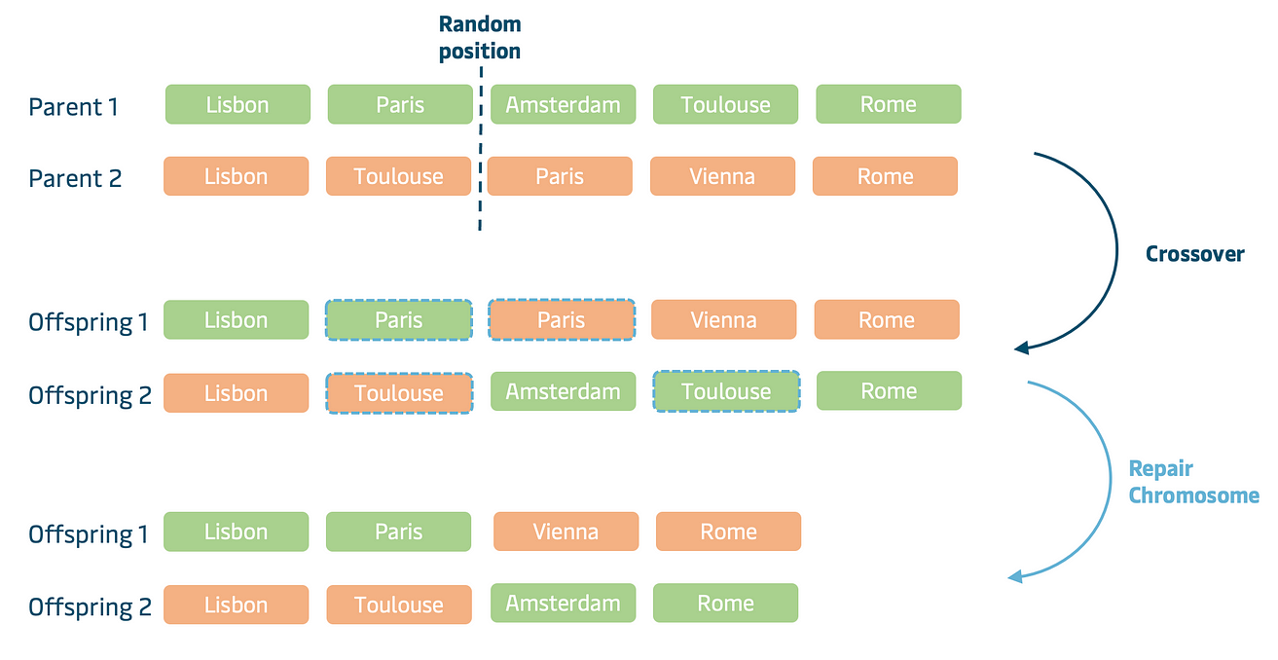
HOW Crossover WORK

Slide 12
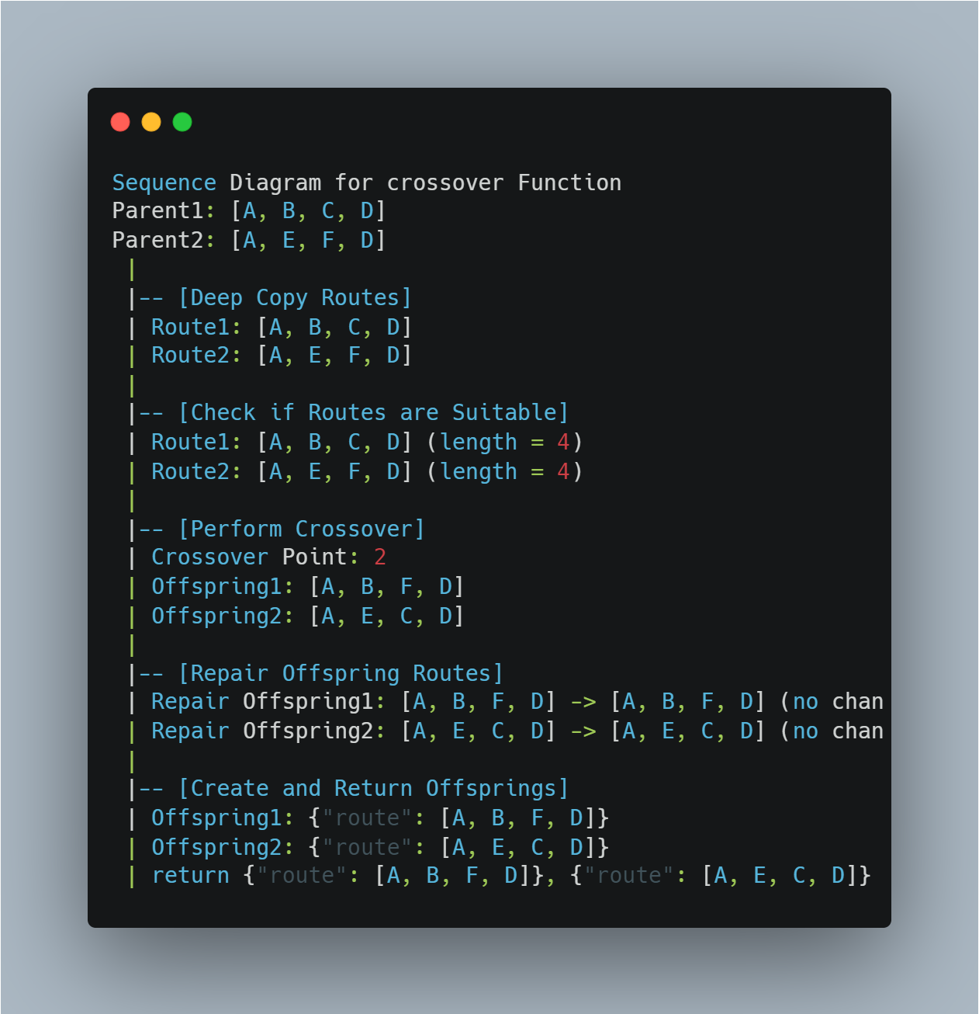
HOW Crossover WORK

Slide 13
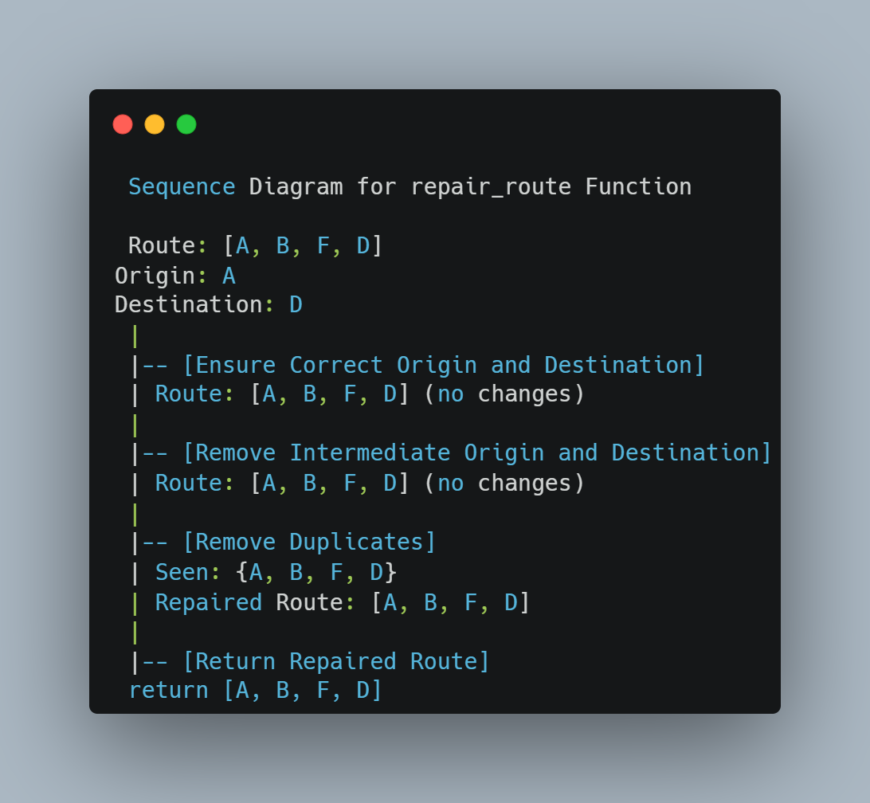

Slide 14
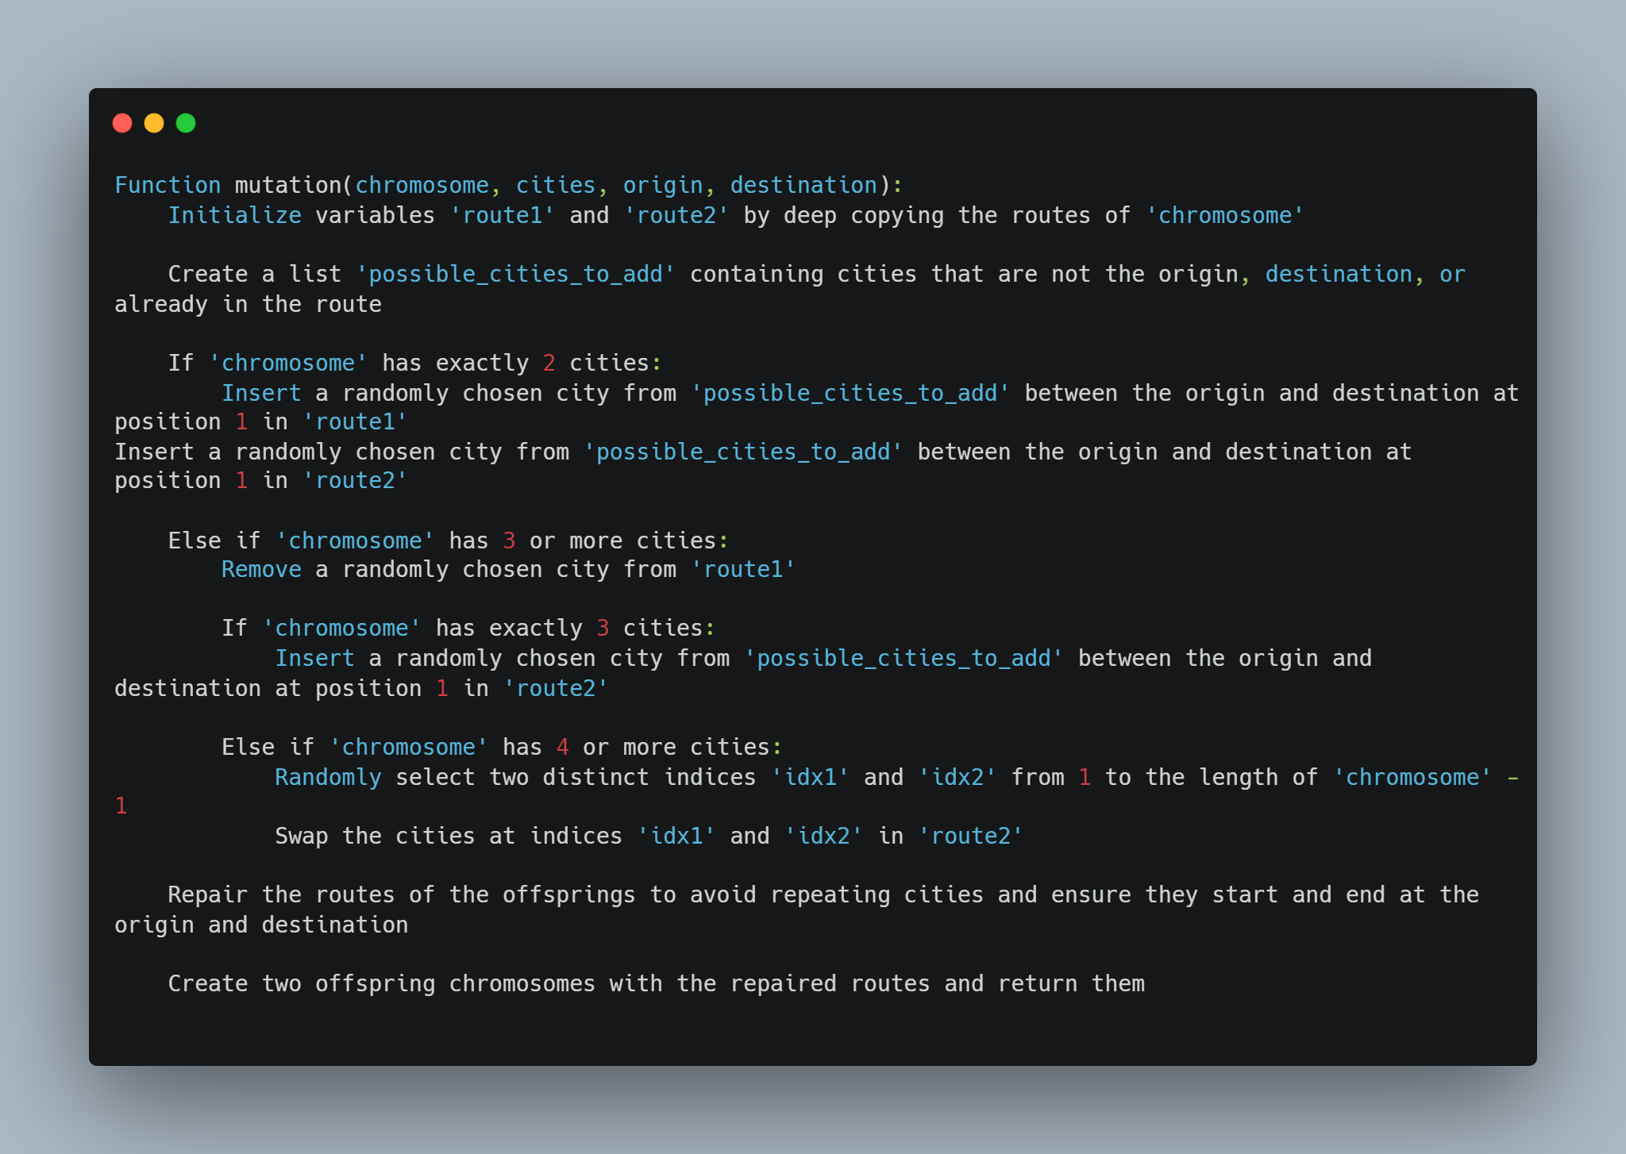
mutation
This function applies mutation to a chromosome to create two new chromosomes with slightly modified routes. Adjustments may be needed based on the specific requirements of your Genetic Algorithm implementation.

Slide 15
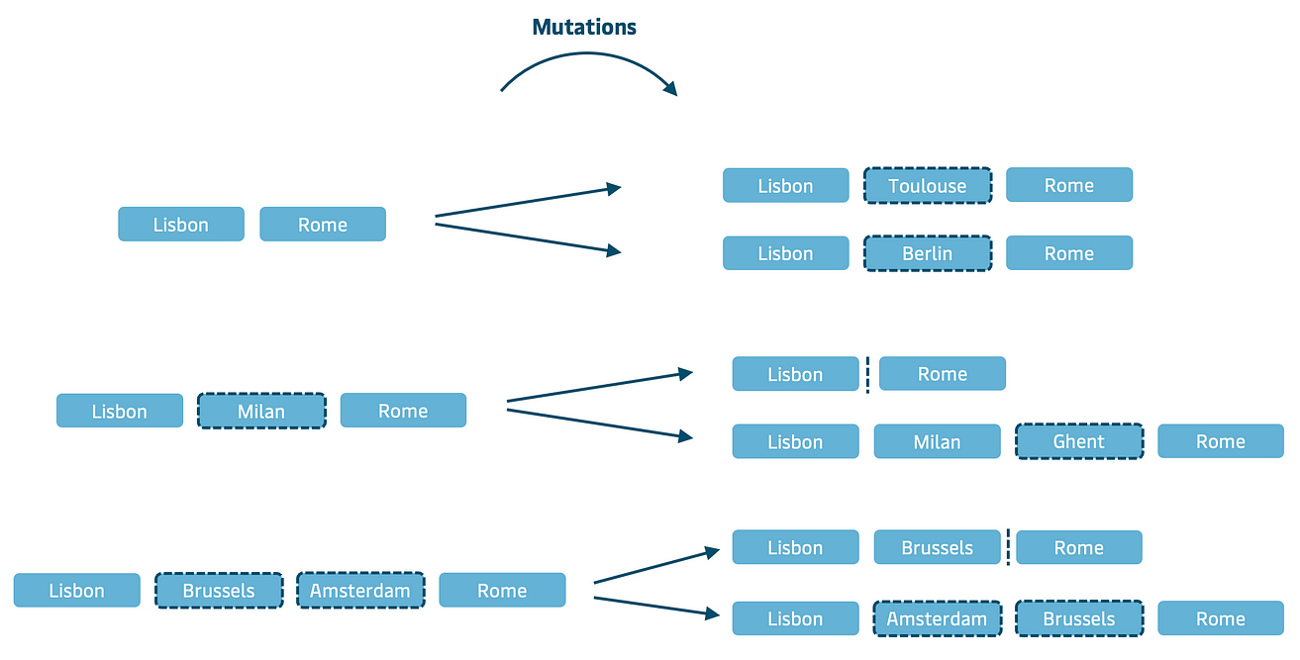
How mutation work

Slide 16
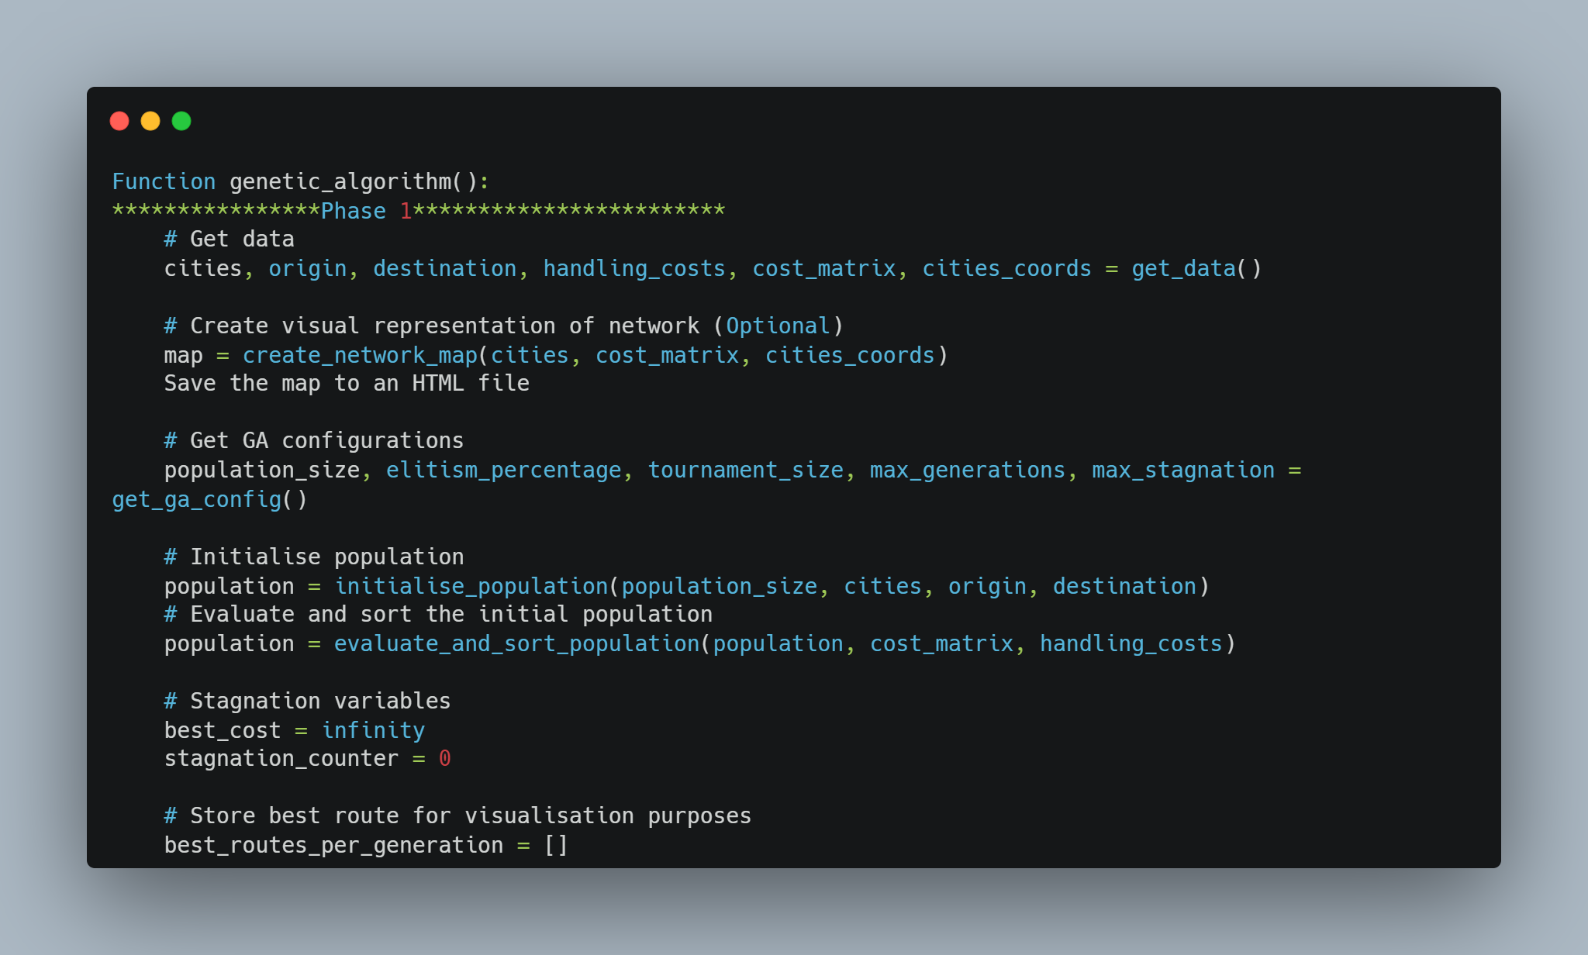
Running the Genetic Algorithm
This phase sets up the initial conditions and prepares the algorithm for iterative generations. The subsequent loop, not detailed here, would involve the iterative application of selection, crossover, and mutation operations on the population until termination conditions are met.

Slide 17
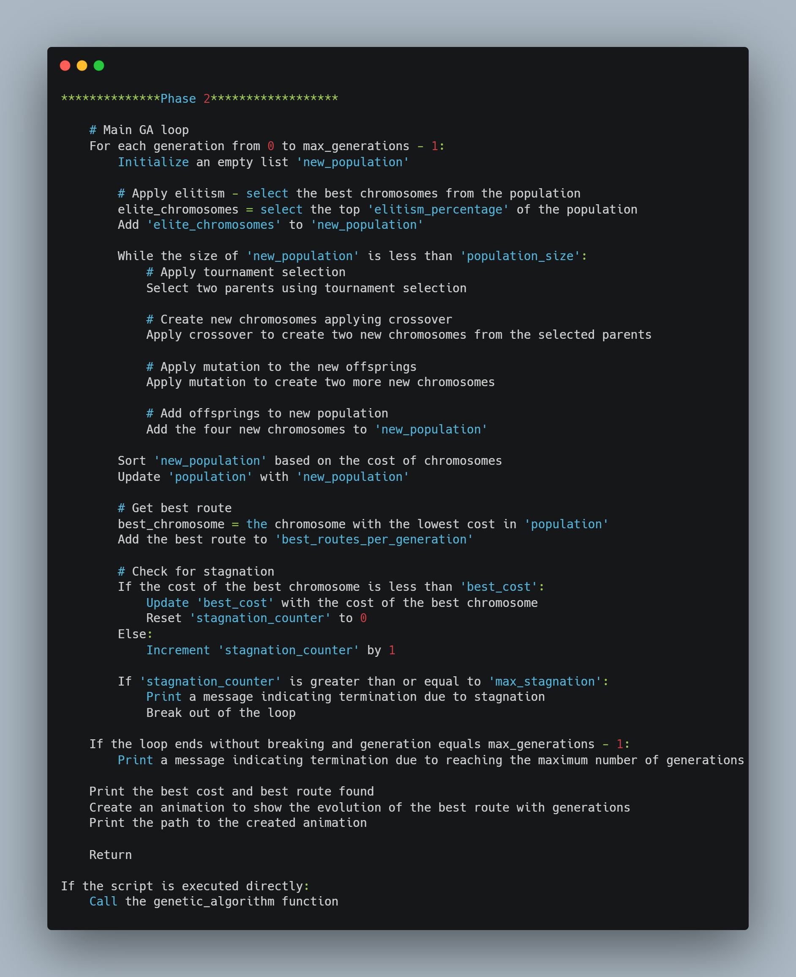

Slide 18
Conclusion
Genetic Algorithms (GAs) are powerful optimization tools adept at efficiently exploring large solution spaces. They exhibit robustness in handling complex, multi-dimensional problems with nonlinear constraints. GAs dynamically adapt to changing environments and evolving constraints, ensuring global optimization. Despite challenges like parameter tuning, their interpretability and ability to find global optima make them valuable. Advancements in algorithms and computing continue to enhance their efficacy. GAs stand as a testament to the power of evolutionary computing in addressing complex optimization challenges. They remain at the forefront of innovation, driving efficiency and unlocking new possibilities in problem-solving.

Slide 19
Q&A
questions?
Go To GOOGLE and ask him → https://www.google.com/

Slide 20
Thank You
In Finally Genetic algorithm has nothing to do with genes.

